Slide 1

1 .This Is Splash Screen Of Application

Slide 2
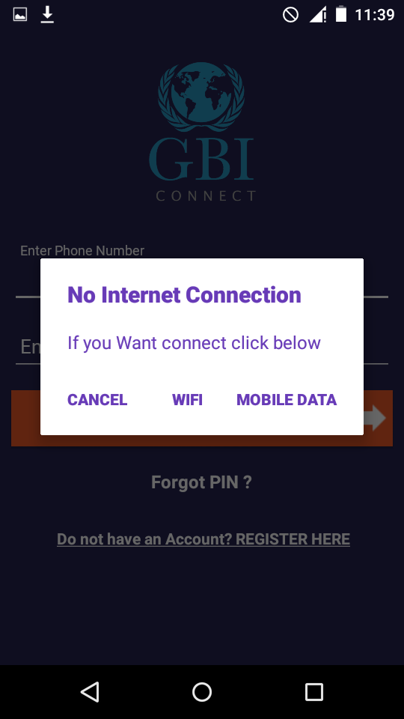
2 .Login Screen If network is Not Connected will be Show AlertDailog with Settings

Slide 3
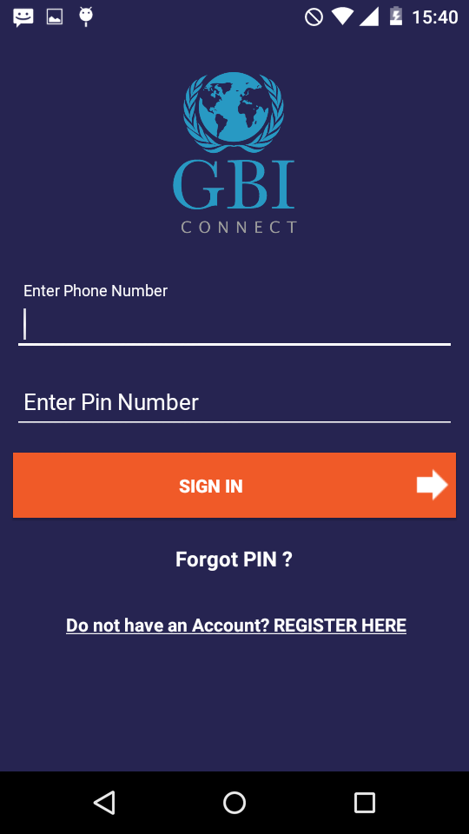
3. Login Screen

Slide 4
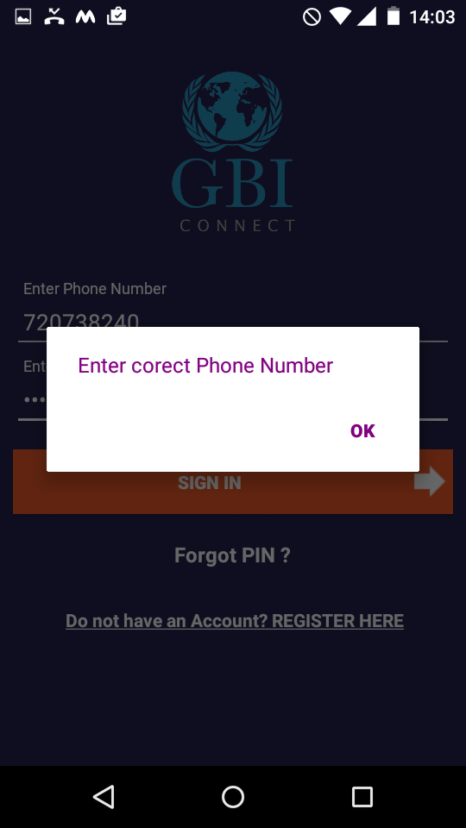
3.A If Enter Wrong Number Will be Show AlertDialog

Slide 5
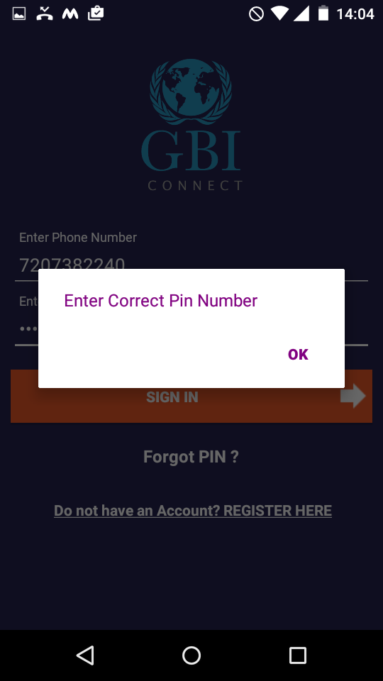
3.B If Enter Wrong pin will show AlertDialog.

Slide 6
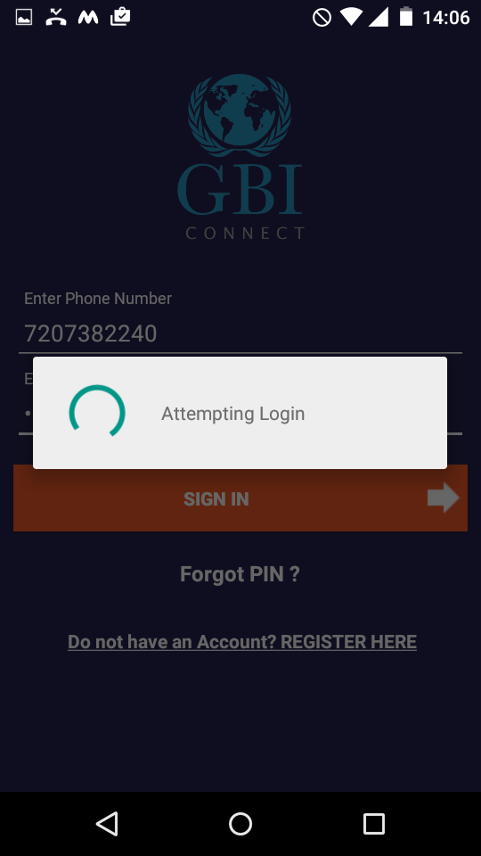
3.C After Enter credentials have Attempting Login

Slide 7
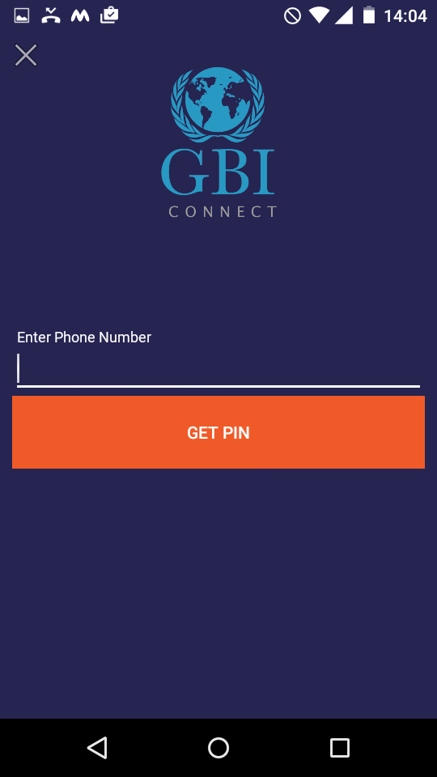
4. Forgot Pin Screen.

Slide 8
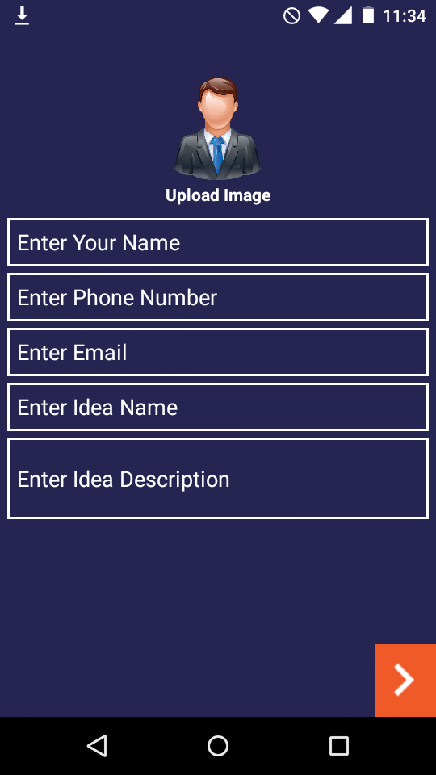
5. Registration Personal Information Screen

Slide 9
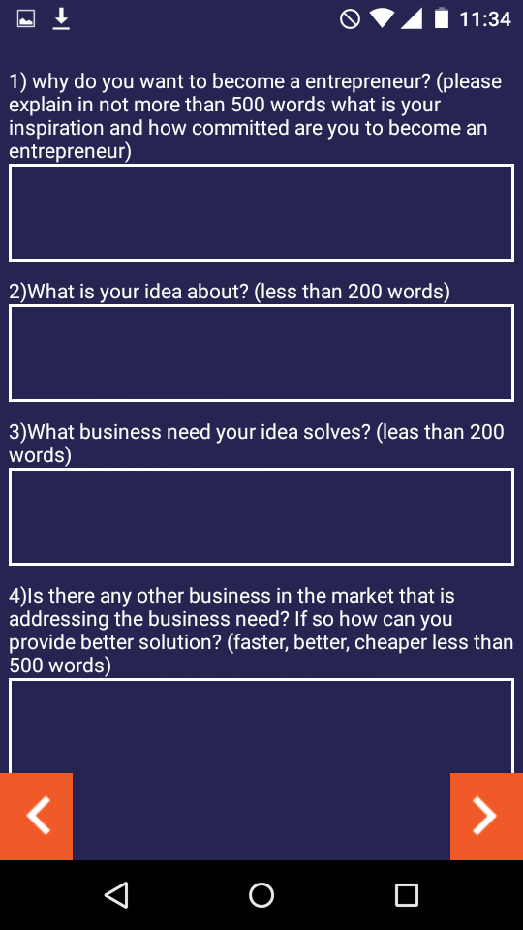
5.A Questionnaire First Screen

Slide 10
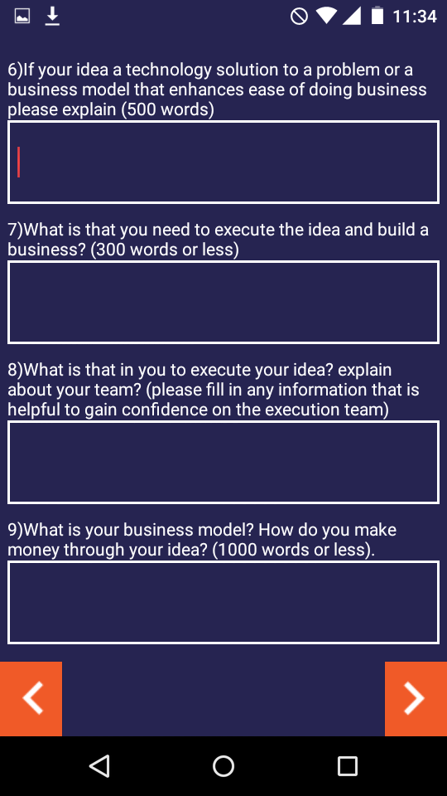
5.B Questionnaire Second Screen

Slide 11
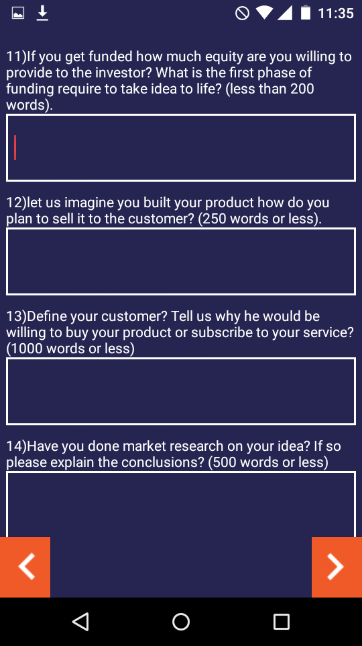
5.C Questionnaire Third Screen

Slide 12
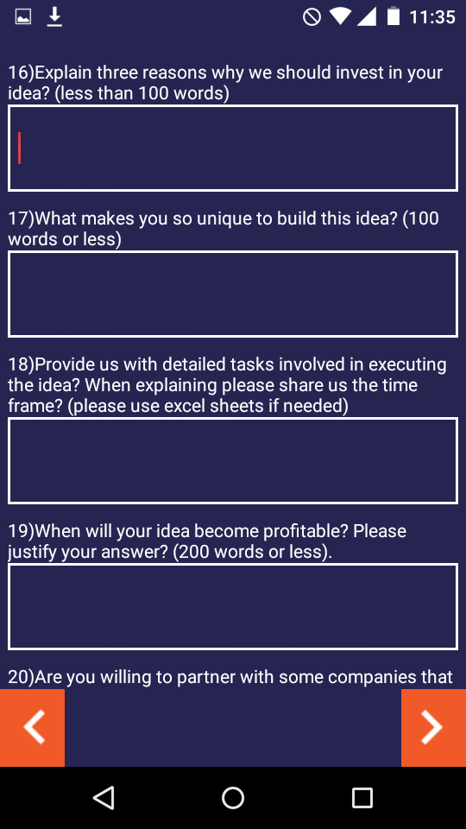
5.D Questionnaire Fourth Screen

Slide 13
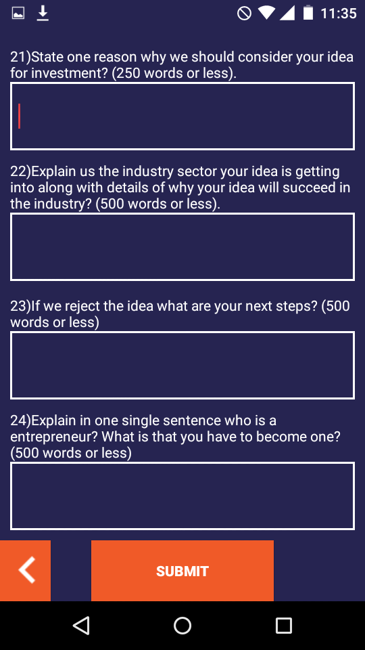
5.E Questionnaire Fifth Screen

Slide 14
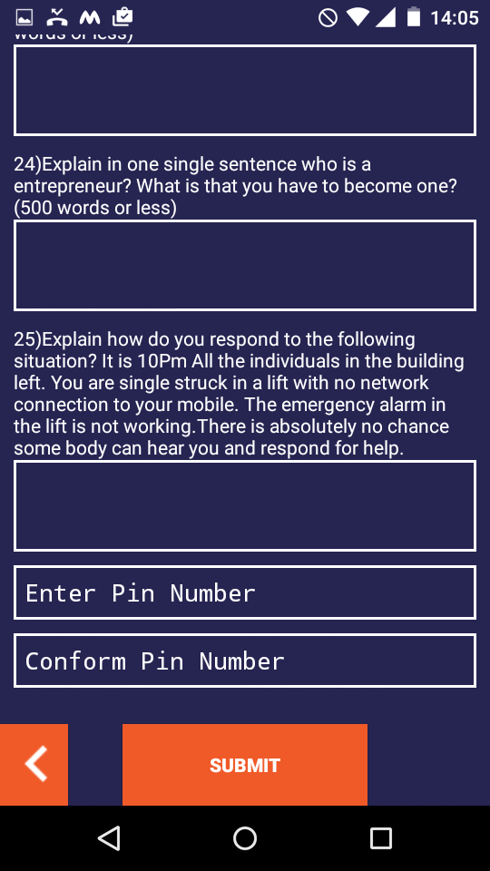
5.F Pin And Confirm Pin Functionality In Questionnaire Fifth Screen

Slide 15
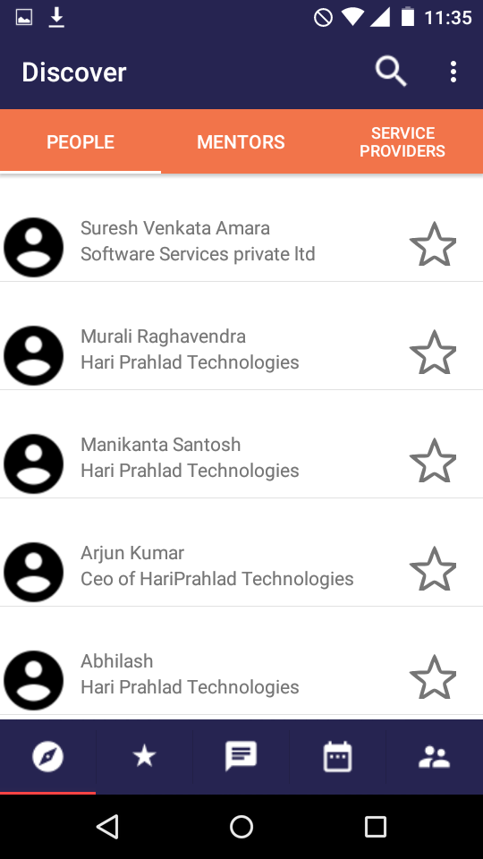
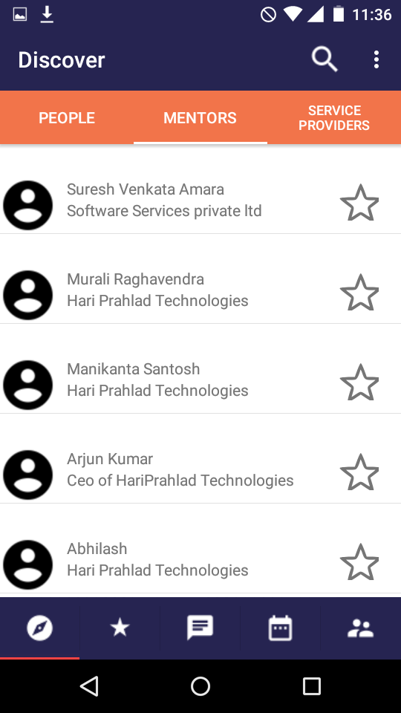
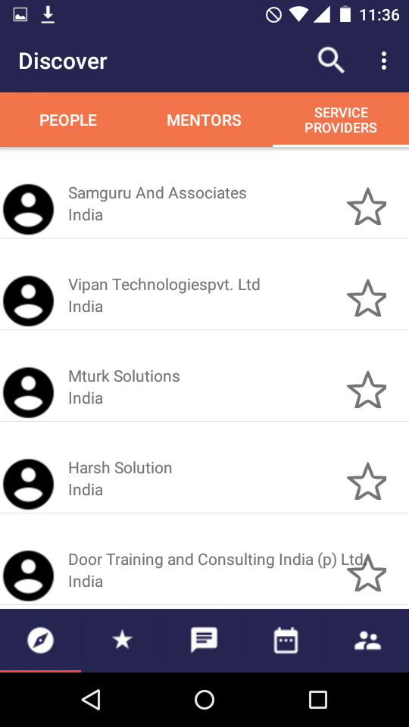
6.A Home screen with Discovery Tab
In Discovery Service Prividers Fragment
In Discovery Peoples Fragment
In Discovery Mentors Fragment

Slide 16
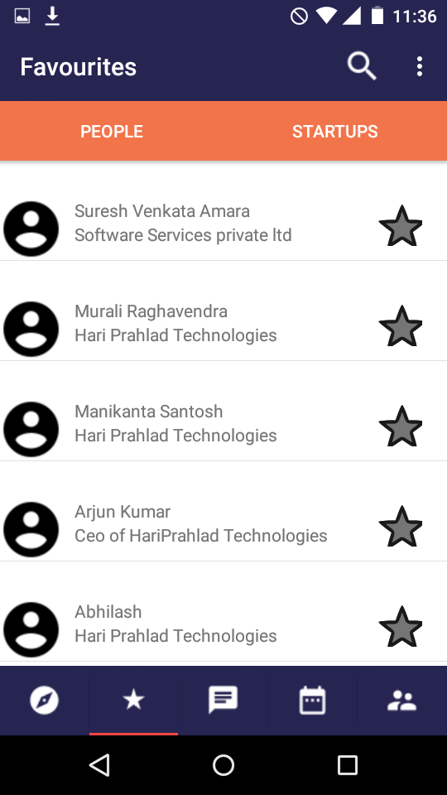
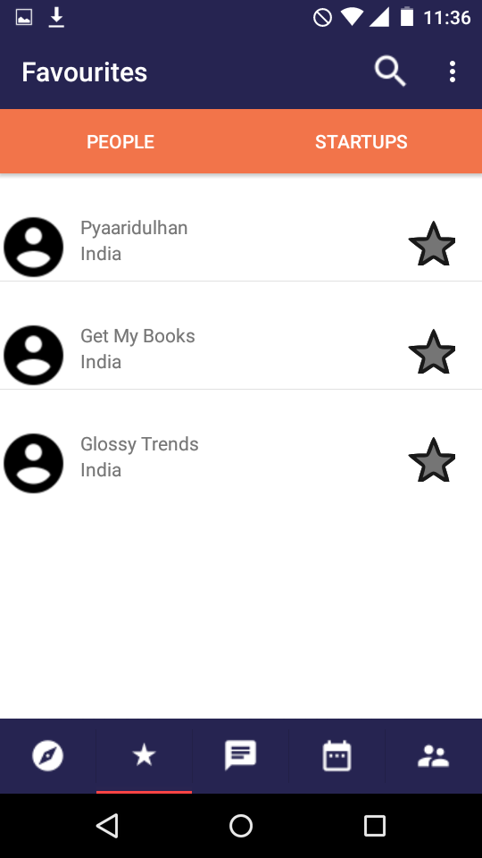
6.B Home screen with Favorites Tab
Favorites With Peoples Fragment
Favorites With Startups Fragment

Slide 17
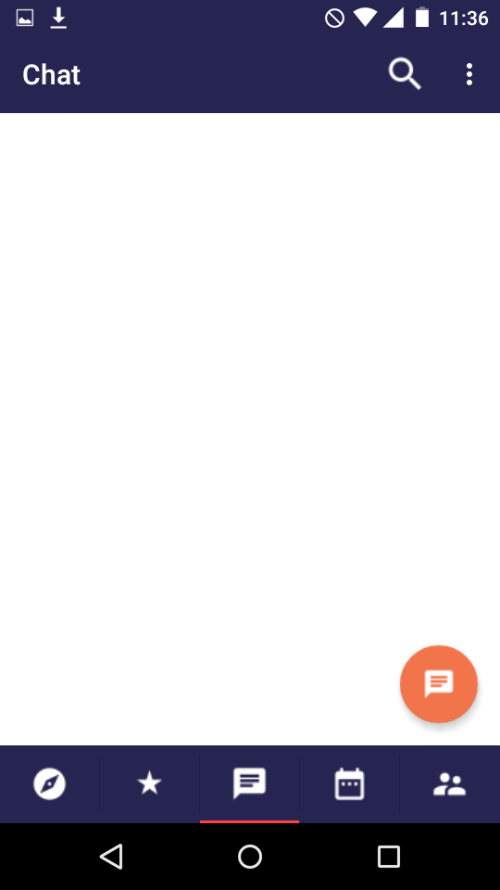
6.C Home screen with Chat Tab

Slide 18
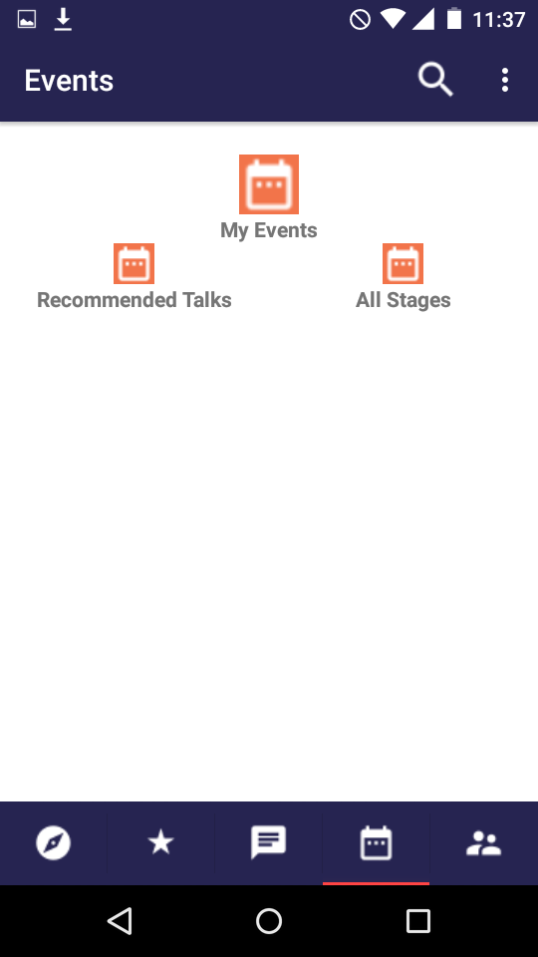
6.D Home screen with Shedule Tab

Slide 19
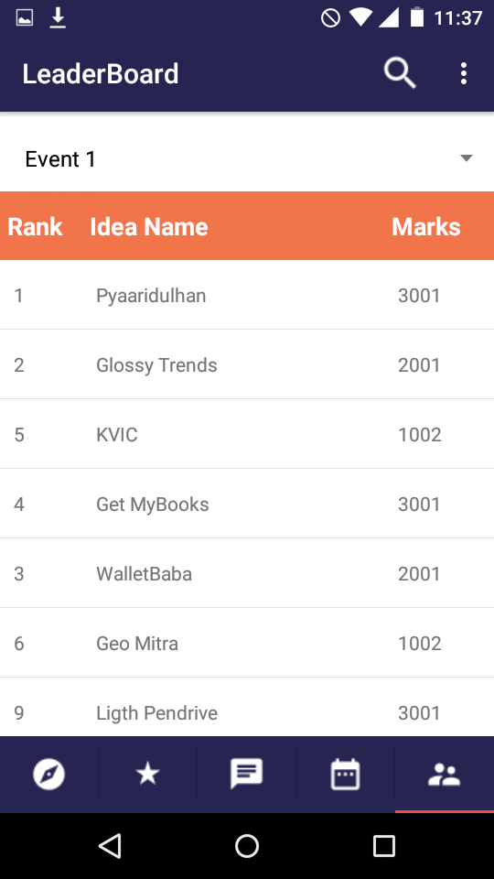
6.E Home screen with Leader Board Tab

Slide 20
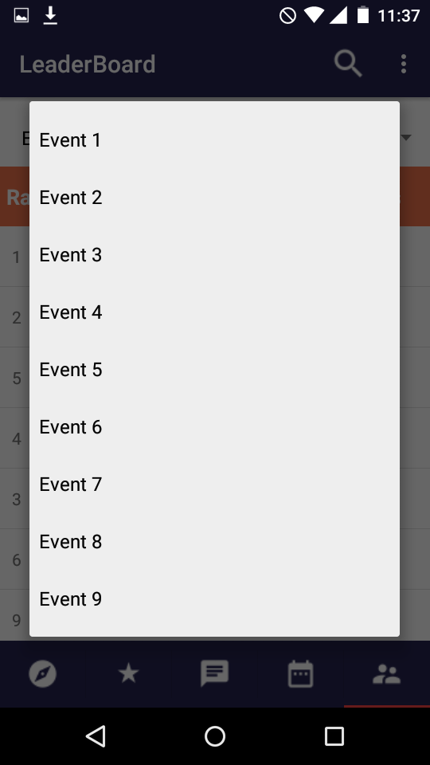
6.E.1 Home screen with Leader Board Tab
If We Click On Spinner Will be Show No.of Events.

Slide 21
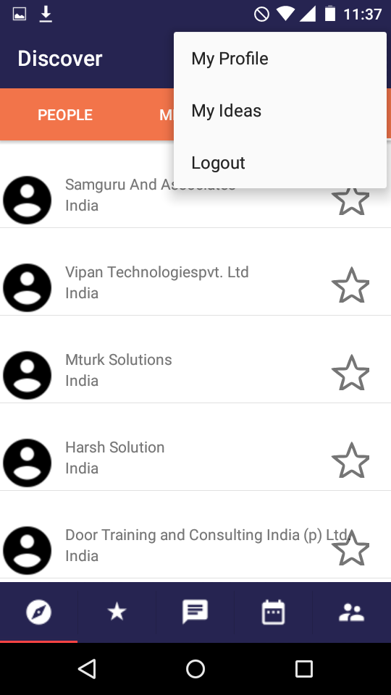
7. When We Click On Options Menu Showing No.of Options

Slide 22
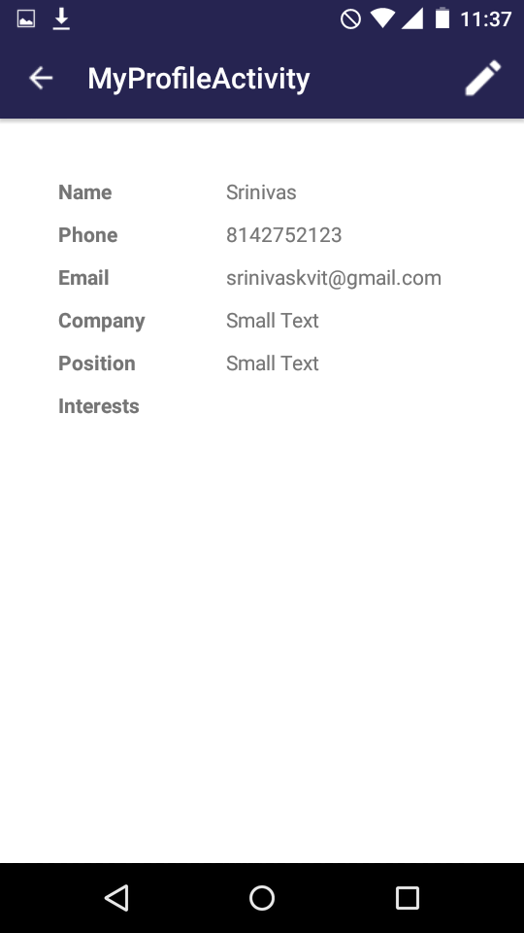
7.A This is A My Profile Activity Screen
If We Want Upload Profile Click On Actionbar then showing upload Profile Screen.

Slide 23
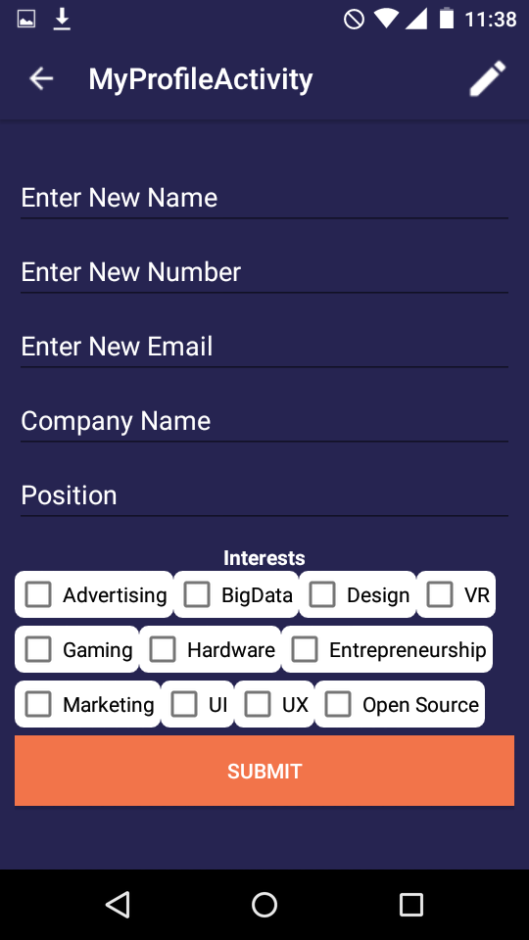
7.A.1 Upload Profile Screen

Slide 24
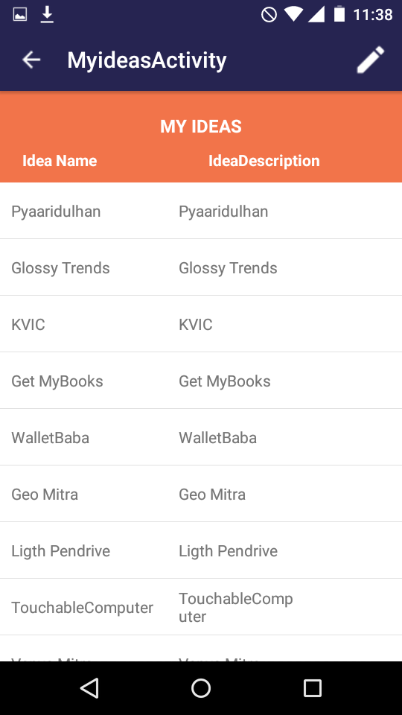
7.B My Ideas Screen
If We Want Add new Idea Click On Actionbar then showing New Idea Screen.

Slide 25
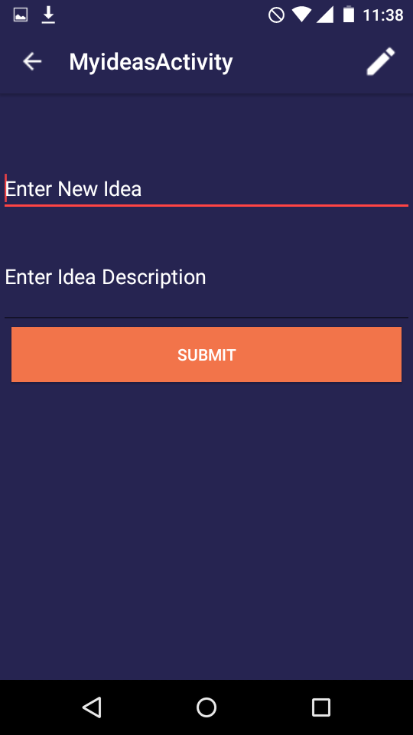
7.B.1 Add New Idea Screen

Slide 26
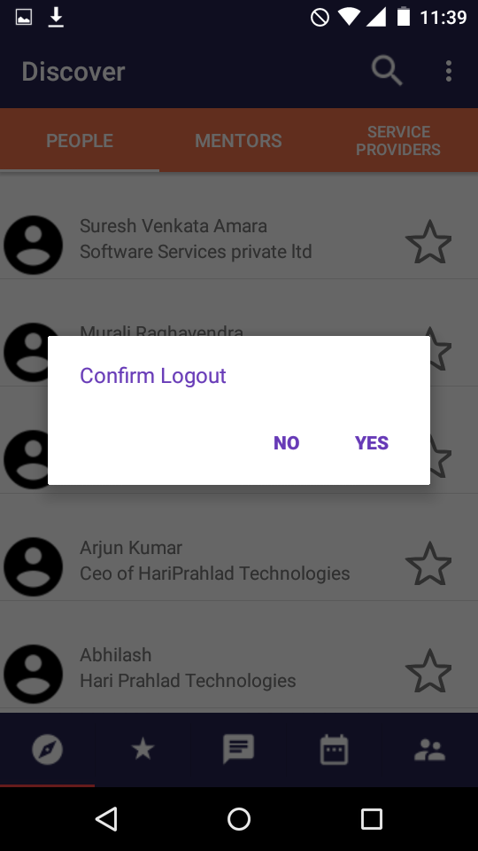
8 If Click On Logout its Asking Confirmation With Alertdailog.

Slide 27
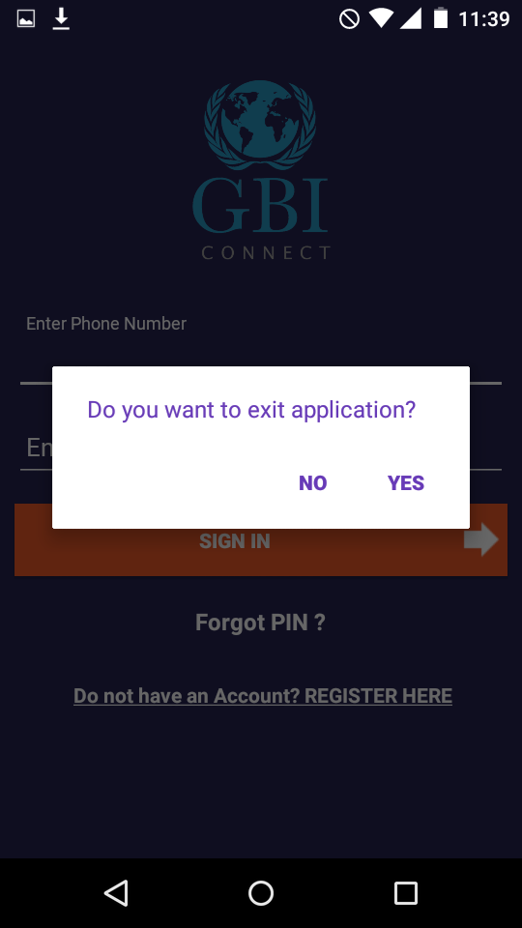
8 If Click Back button in Login Screen its Asking Confirmation With Alertdailog.

